Slide 1

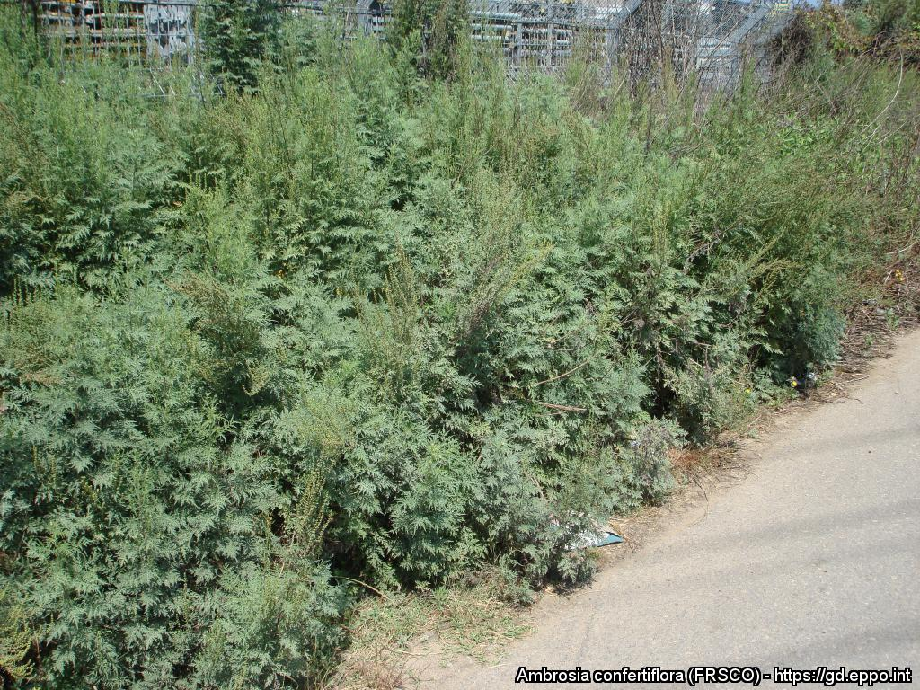
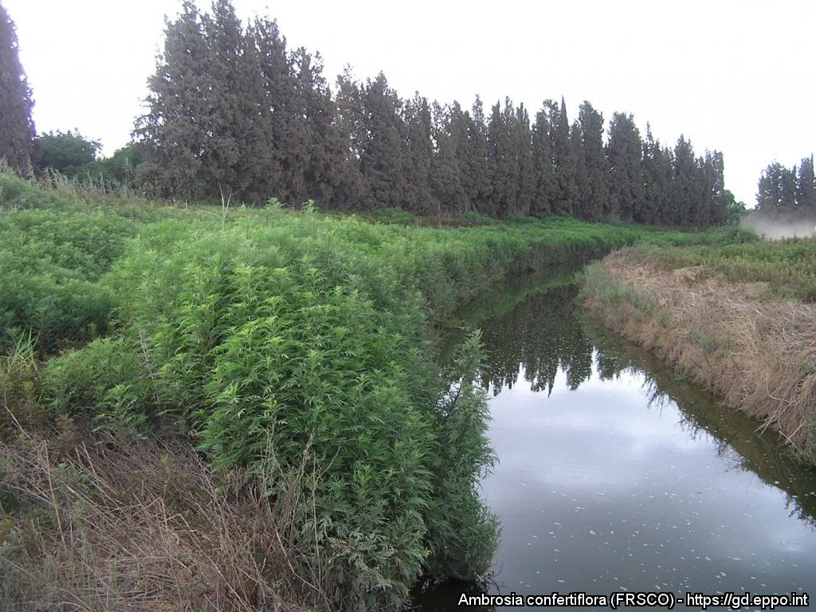
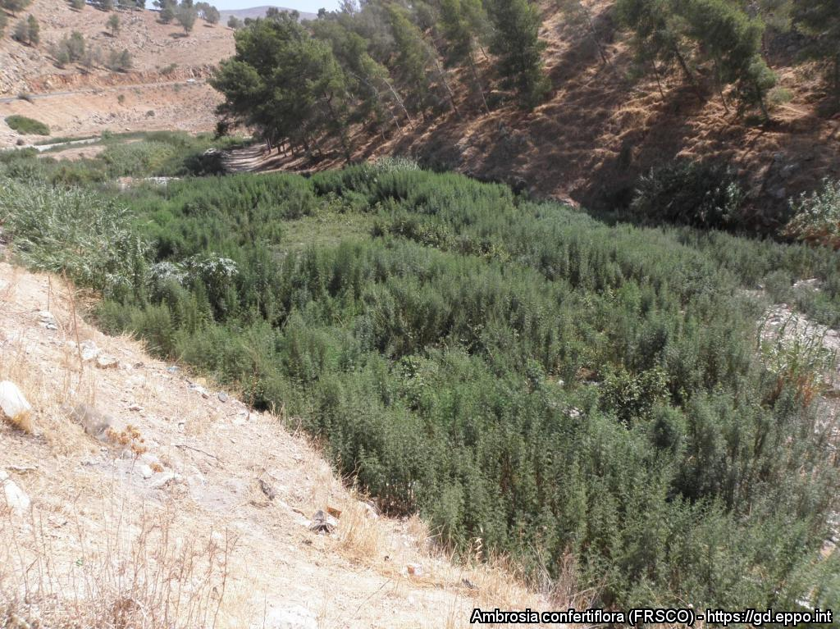

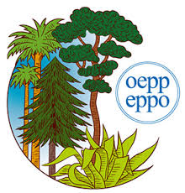

^{BE AWARE!}
^{Ambrosia confertiflora}
^{A threat to the EPPO region}
Image: Jean-Marc Dufour-Dror EPPO Global database, https:\\gd.eppo.int
What is it?
Ambrosia confertiflora (EPPO List of invasive alien plants) is an erect perennial herb (Hemicryptophyte) native to North America and non-native to Australia and Israel. The species is absent from Europe. In Israel, Ambrosia confertiflora occurs in various natural and disturbed habitats, including dry plains and semi-arid valleys, degraded pastures, cultivated orchards, summer field crops (cotton and water melon) avocado and date groves, along roadsides, river-banks, and wadi beds (dry river beds), in wastelands and other disturbed areas.
There is no clear information on the pathway of entry of A. confertiflora into the EPPO region (Israel). Contamination of livestock from Australia, animal seed mixture and contamination of machinery by seed are all possible pathways. A. confertiflora forms dense stands that can outcompete native plant species. A monoculture can act to suppress understory native plants which results in environmental impacts, in particular in humid habitats, in grasslands and in dry river beds. The plant competes for nutrients and can spread among cultivated fields and mixes with crops which cannot be harvested properly.
What's the problem?
Infestation of the bank of the Alexander River, Israel
Infestation of a dry riverbed in Israel
Image: Jean-Marc Dufour-Dror EPPO Global database, https:\\gd.eppo.int
Image: Jean-Marc Dufour-Dror EPPO Global database, https:\\gd.eppo.int
Contact us!
Your contact details, logos, links, QR codes …
Learn more about Ambrosia confertiflora: https://gd.eppo.int
This poster has been prepared within the LIFE funded project LIFE15 PRE FR 001

